Slide 1


Natural Language Processing
Hector - Nicholas - Shayan - Jennifer

Slide 2

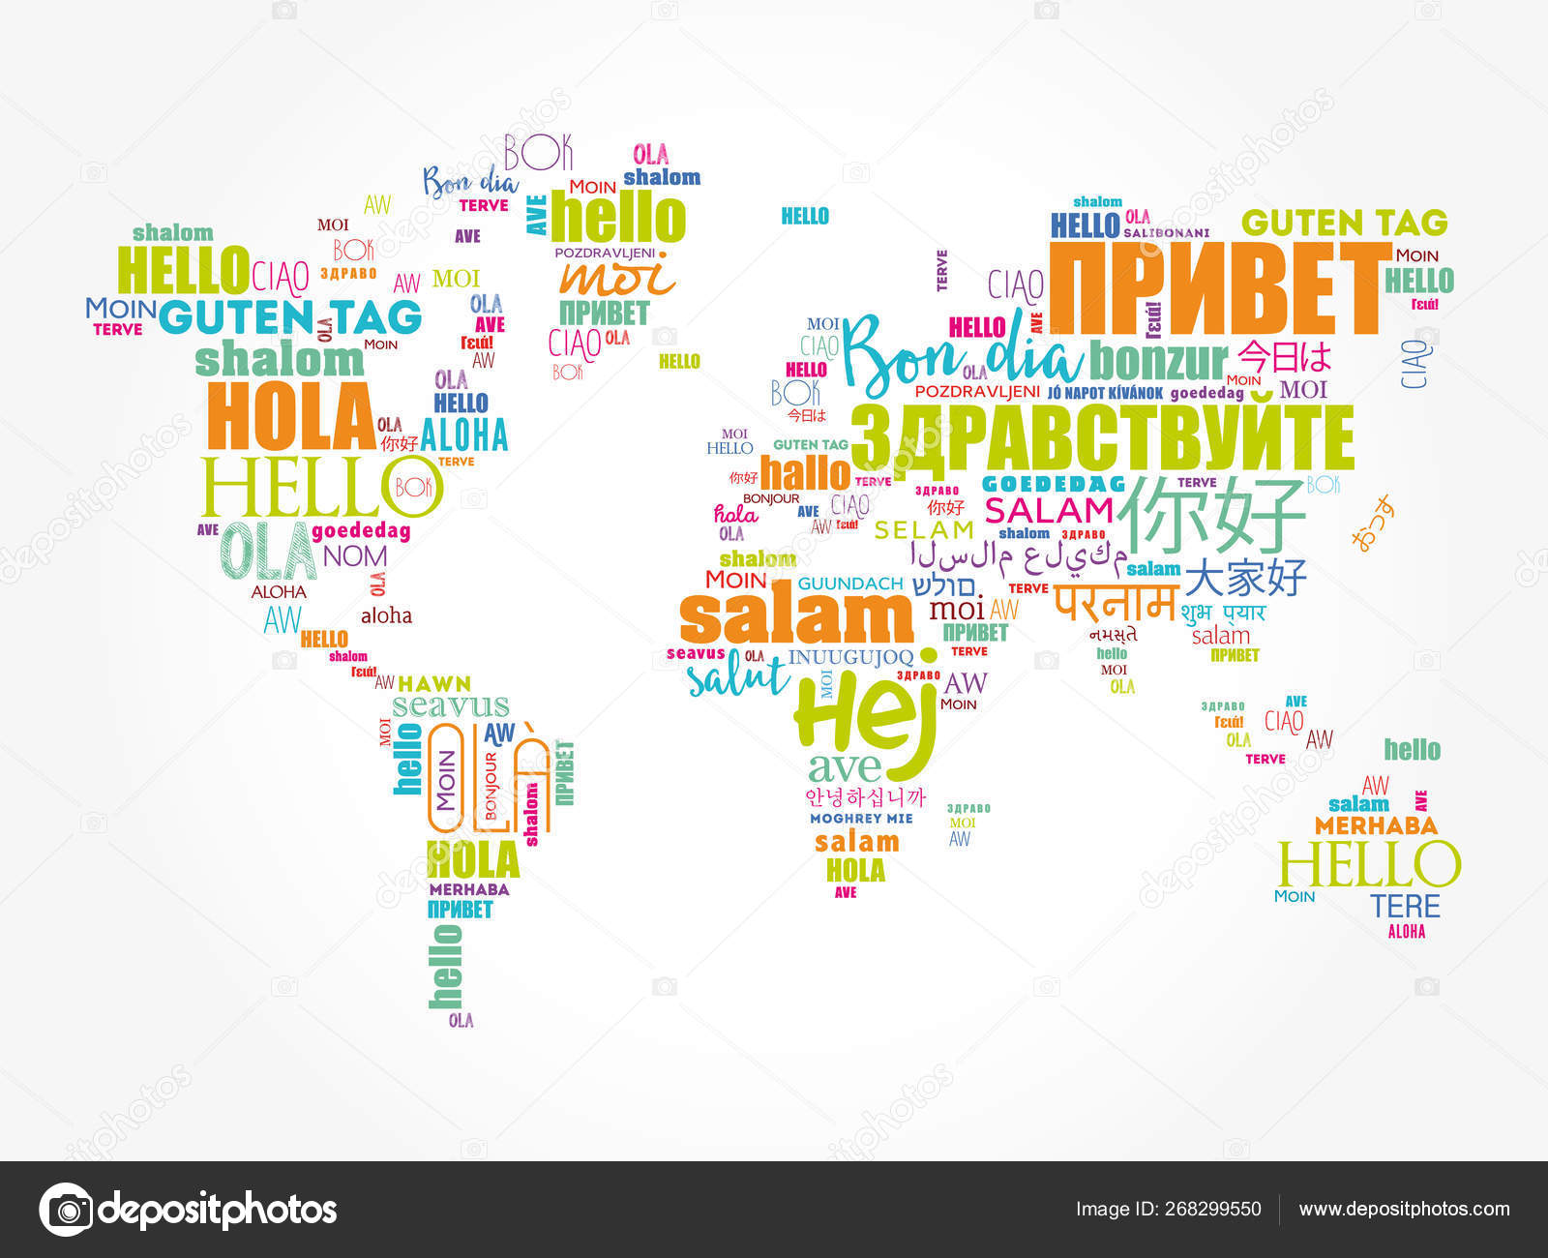

What is NLP (Natural Language Processing) ?
Interactions between computers and human languages
- web search engines
- emails
- social networks
- translations

Slide 3
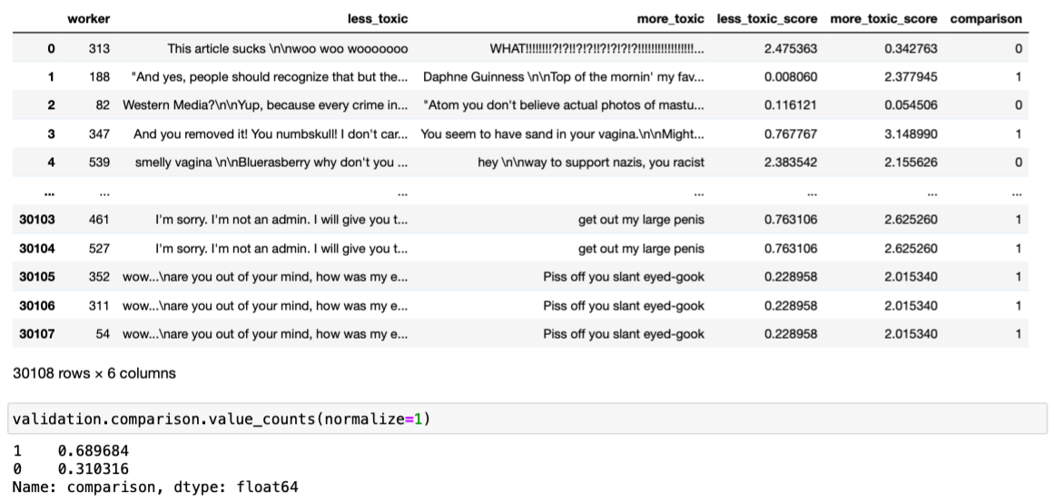
Jigsaw’s Fourth Competition - Rate Severity of Toxic Comments
What is Toxicity? anything rude, disrespectful or otherwise likely to make someone leave a discussion
Our Mission: rank relative ratings of toxicity between comments
higher the degree of toxicity —> higher the score
no training data
validation data:
30108 less_toxic and more_toxic comments respectively

Slide 4
Toxicity score using VADER
VADER (Valence Aware Dictionary and sEntimentReasoner)
Great for sentiment analysis on social media text
No text pre-processing required
Composite scores comparison with less toxic and more toxic comments in validation data set
Accuracy is ONLY 58.3%
Since VADER model is primarily to gauge text sentiment, it may not be a good method for analyzing toxicity.

Slide 5
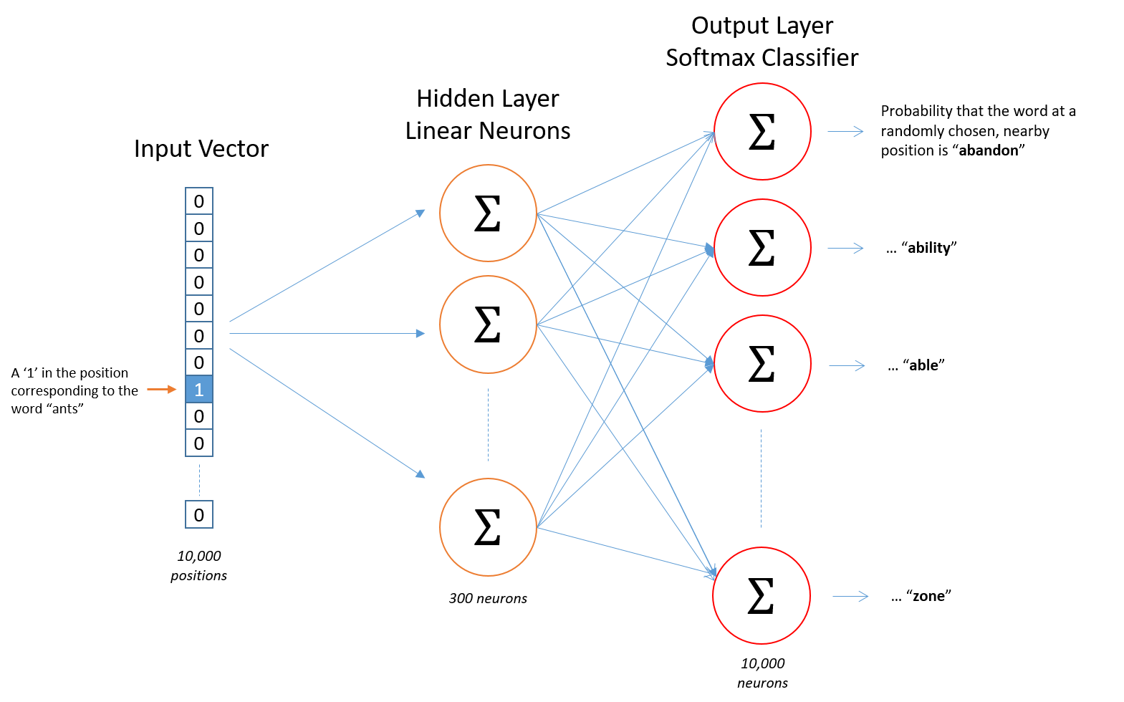
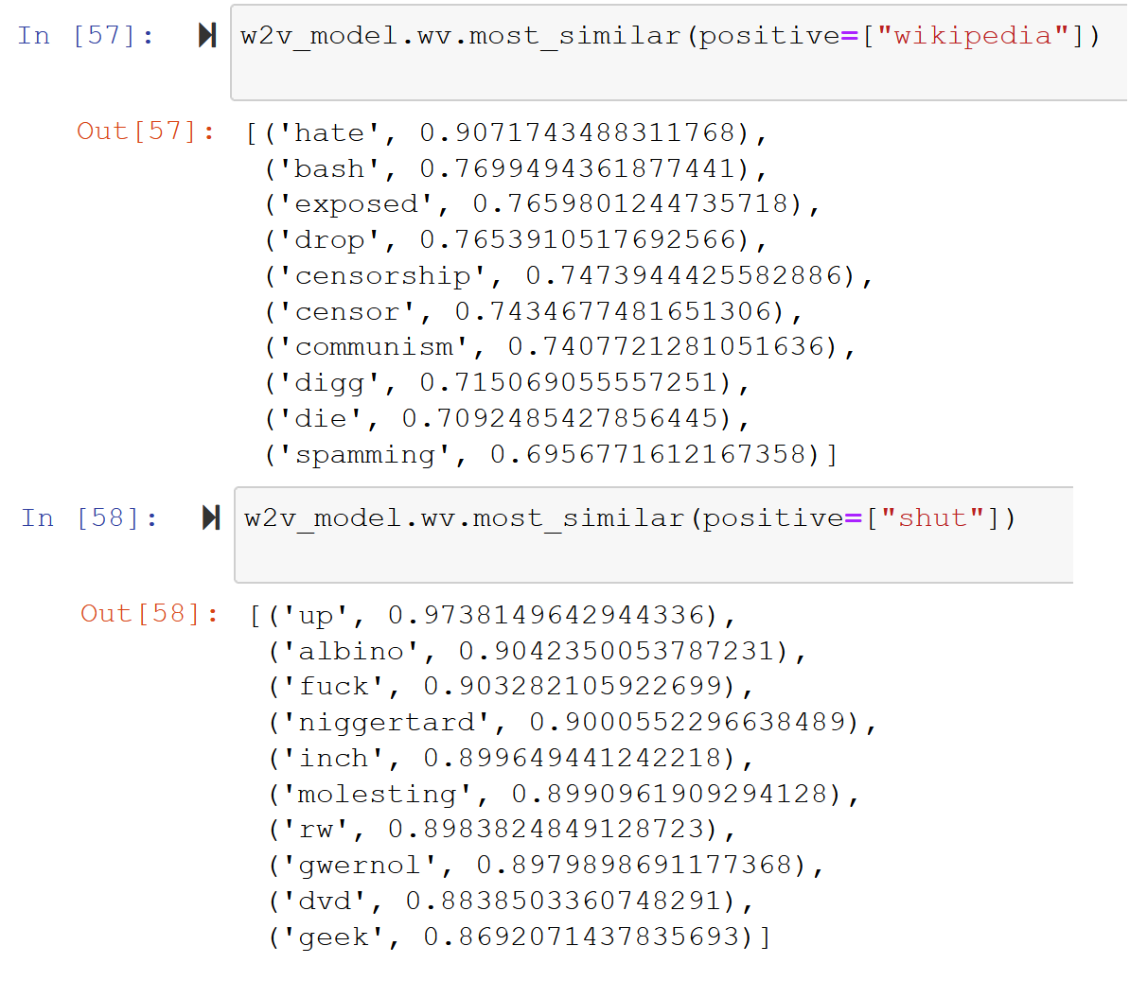
Word2Vec + KMeans Clustering
A method for unsupervised NLP would be useful for our unlabelled dataset
Word2Vec is a neural network that converts words to vectors based on similarity to other words
Neural Net picture: McCormick, C. (2016, April 19). Word2Vec Tutorial - The Skip-Gram Model. Retrieved from http://www.mccormickml.com

Slide 6
Word2Vec + KMeans Cont’d
Word vectors are used in KMeans clustering to be put into 2 groups
Theoretically, they should be divided into “more positive” and “more negative”
Words are then assigned values based on their distance to the centre of the cluster multiplied with their TF-IDF value and their cluster value (1 or -1)
Each comment is then given an overall value

Slide 7
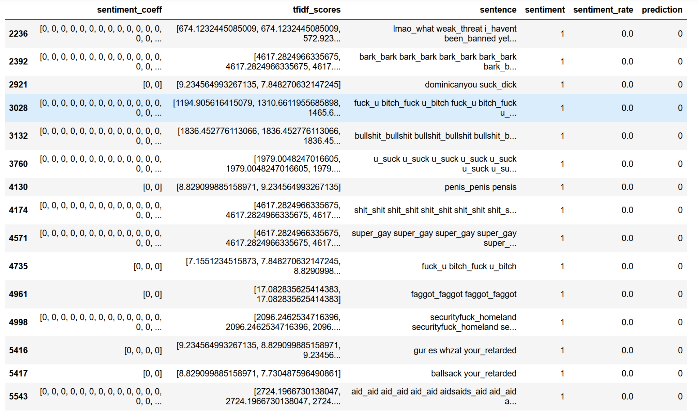
Word2Vec + KMeans Conclusion
Experimenting with different ways of preprocessing the text, I found that the best result (63.2%) was found with stopword removal and lemmatization
Surprisingly, using bigrams performed worse
I suspect this is due to the nature of our dataset, people would repeat words excessively messing up the bigram detector
Overall, it performed poorly but still better than Vader

Slide 8
Word2Vec + KMeans Limitations
Difficult to tune
Many stages of data cleaning between stages (Clean->Word2Vec->Clean->KMeans->Clean->Validate)
Difficult dataset
Positive/Negative sentiments not divided into 50/50
If it was divided even KMeans word work better
Misspelled words cause difficulty
Assumption that the data will split into Positive/Negative sentiments

Slide 9
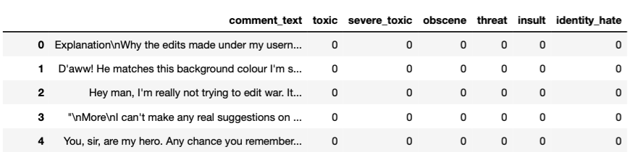
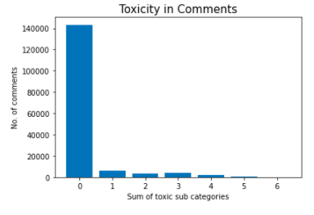
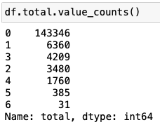
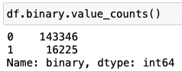
LSTM from 1st competition balanced dataset
6 toxic subcategories
downsampled, left with 32450 toxic and non-toxic comments
Data Cleaning
comments are messy: incorrect spellings, repeated words, slang, punctuation, etc
tried various technique for cleaning: stopwords, URL, punctuation, extra white spaces

Slide 10
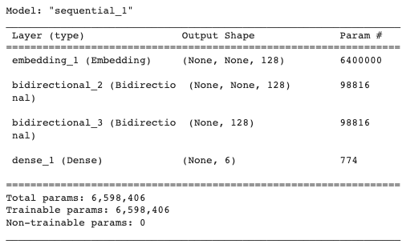
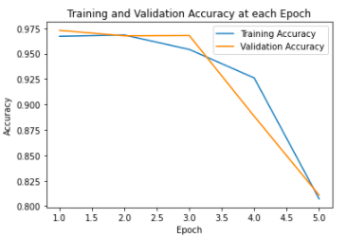
LSTM cont’d
Text converted to numerical sequences using Tokenizer.
Vocabulary size = 50k
Max_len = 200
Preprocessed comments passed to LSTM
Training size= 26000
Test size = 6450
Model trained for 5 epochs.
Predictions generated for our validation data for each sub category.
Sum of the categories is used as the final toxicity score
Accuracy on the validation data is 68.2%

Slide 11
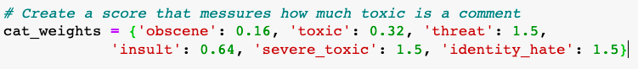
Ridge Regression with tf-idf
Similar to the first example, we have also taken balanced dataset from Kaggle’s first competition.
Each of the sub-categories is assigned a weight to predict toxicity score (relative to person and using intuition)
After text cleaning, the comments are converted into a matrix using the TfidfVectorizer
This is used as input to train our Ridge regression model with target variable toxicity score
The Ridge regression model was tuned to best alpha value=0.5 and achieved a score comparison accuracy of 68.46%

Slide 12
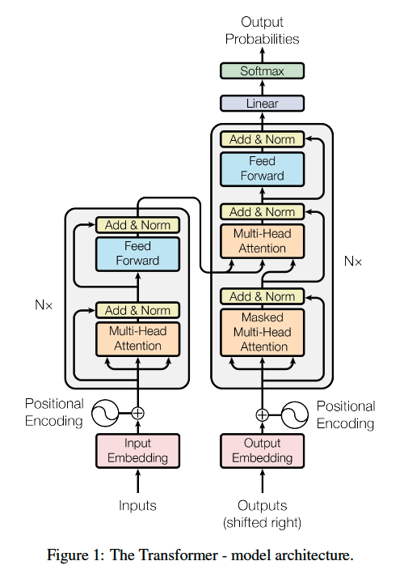
Transformer Neural Network
an article “Attention is all you need ” was published by Google in 2017
initially created for Machine Translation
rely entirely on self-attention to compute input sequences and output sequences

Slide 13
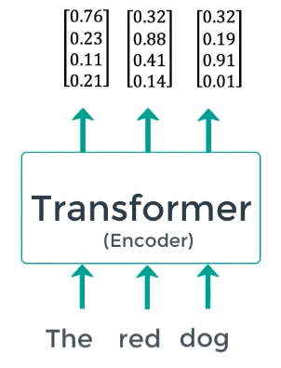
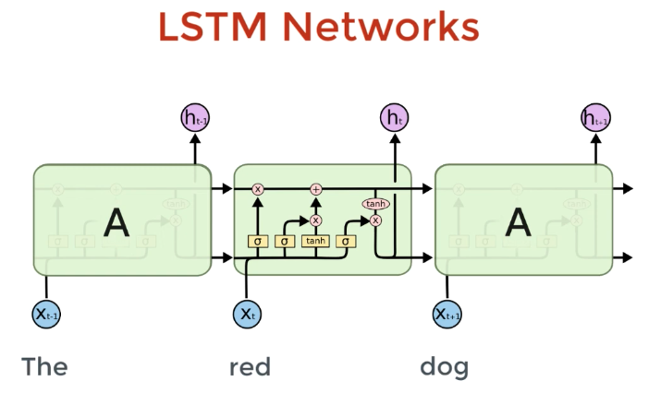
LSTM vs Transformer
input words are passed in sequentially
slower to train
words can be processed simultaneously
faster to train

Slide 14
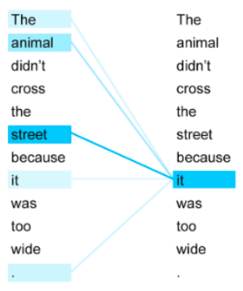
Self-attention
“it” refers to the street or the animal ???
passing the entire sentence at the same time allows the model to pay attention to the other words
get a better understanding of a certain word

Slide 15
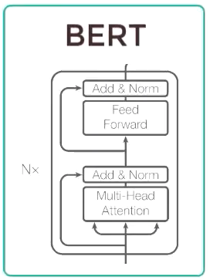
BERT (Bidirectional Encoder Representation from Transformers)
Problem to Solve
Neutral Machine Translation
Question Answering
Sentiment Analysis
Text Summarization
How ?
pre-train BERT to understand language
fine-tune BERT to learn specific task
require the understanding of language

Slide 16
Pre-training by Google on the whole English Wikipedia and Brown Corpus
Fune-tuning by us on the training data from the Kaggle Competition
Result
 | Cleaning | Classes | Sampling | Epochs | Accuracy
v1 | No | multiple | downsampling | 2 | 0.695098
v2 | No | binary | upsampling | 5 | 0.646506
v3 | light cleaning | multiple | No | 5 | 0.651222
v4 | light cleaning | multiple | downsampling | 2 | 0.640229

Slide 17
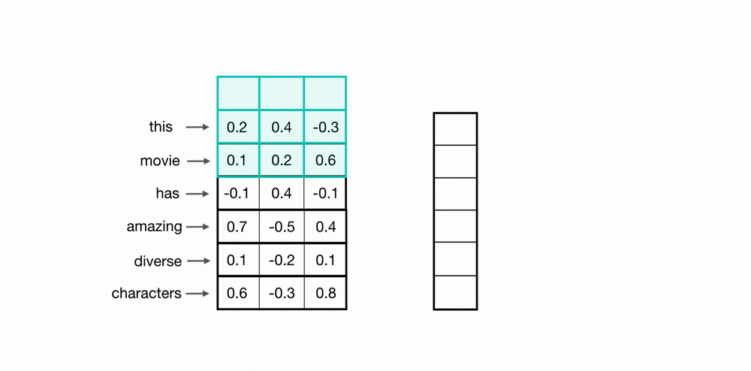
GloVe + 1D CNN Introduction
Super cool! We learned alot about CNN for 2D images. BUT, we can also apply CNN for text classification!
E.g. Facebook

Slide 18
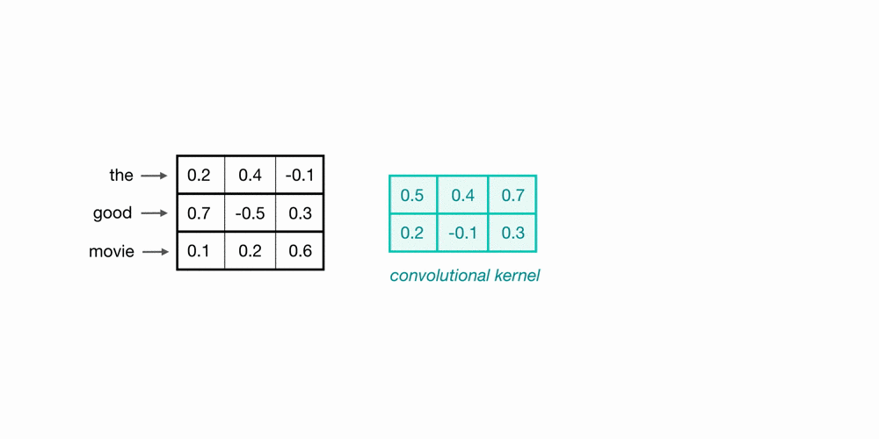
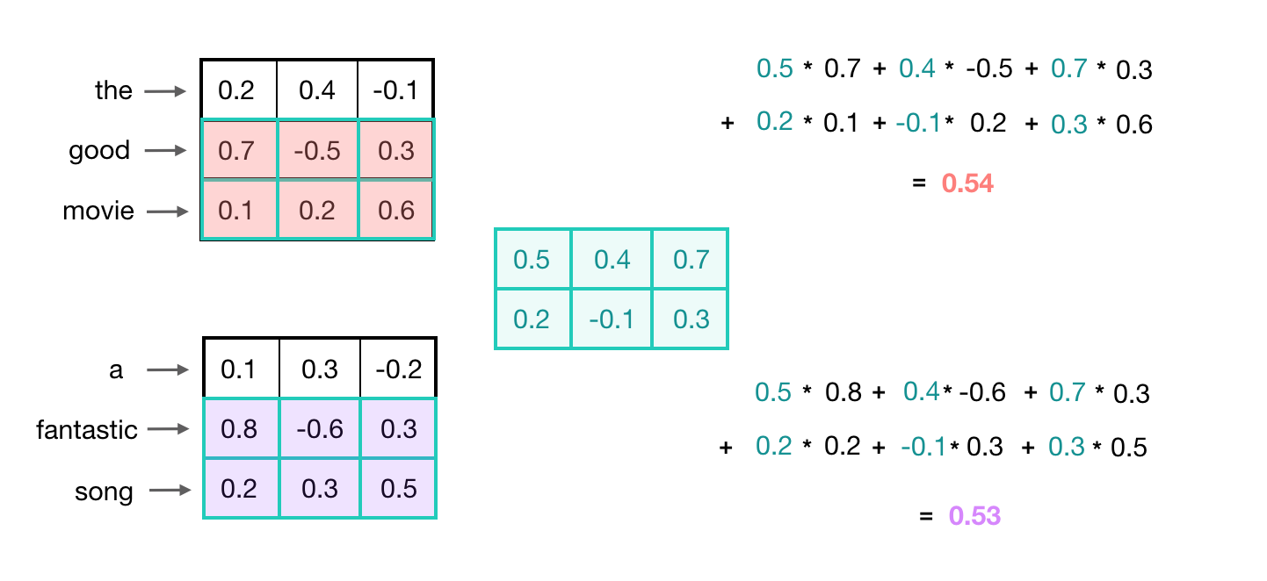
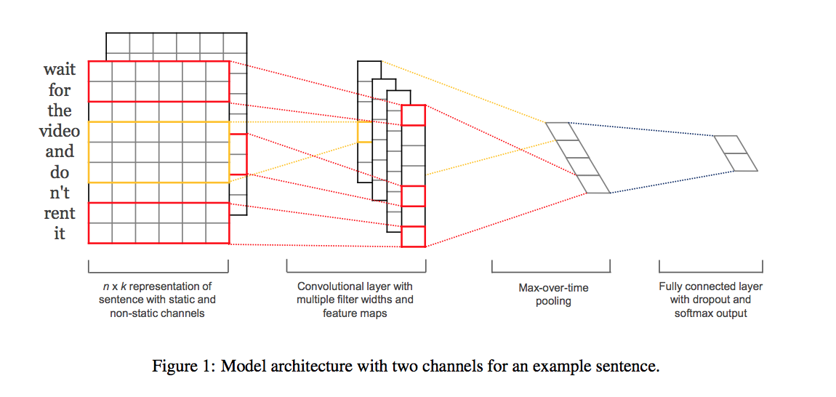
GloVe + 1D CNN Introduction

Slide 19
GloVe + 1D CNN - Steps
Import Libraries
Loading Pretrained model (i.e. GloVe)
Preprocess & Clean data (i.e. Regex)
Convert Sentences (strings) to Integers - Tokenization
Prepare Embedding Matrix (Padding)
Loading Pretrained word embeddings
Train 1D CNN with Kaggle 1st Dataset
Validating Data with Kaggle 4th Dataset

Slide 20
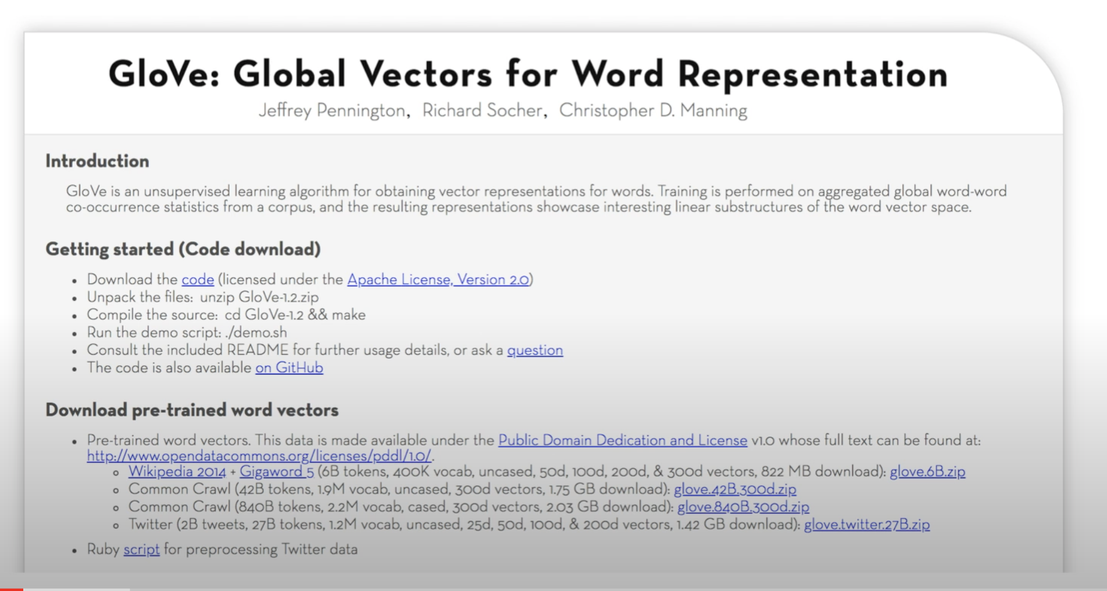
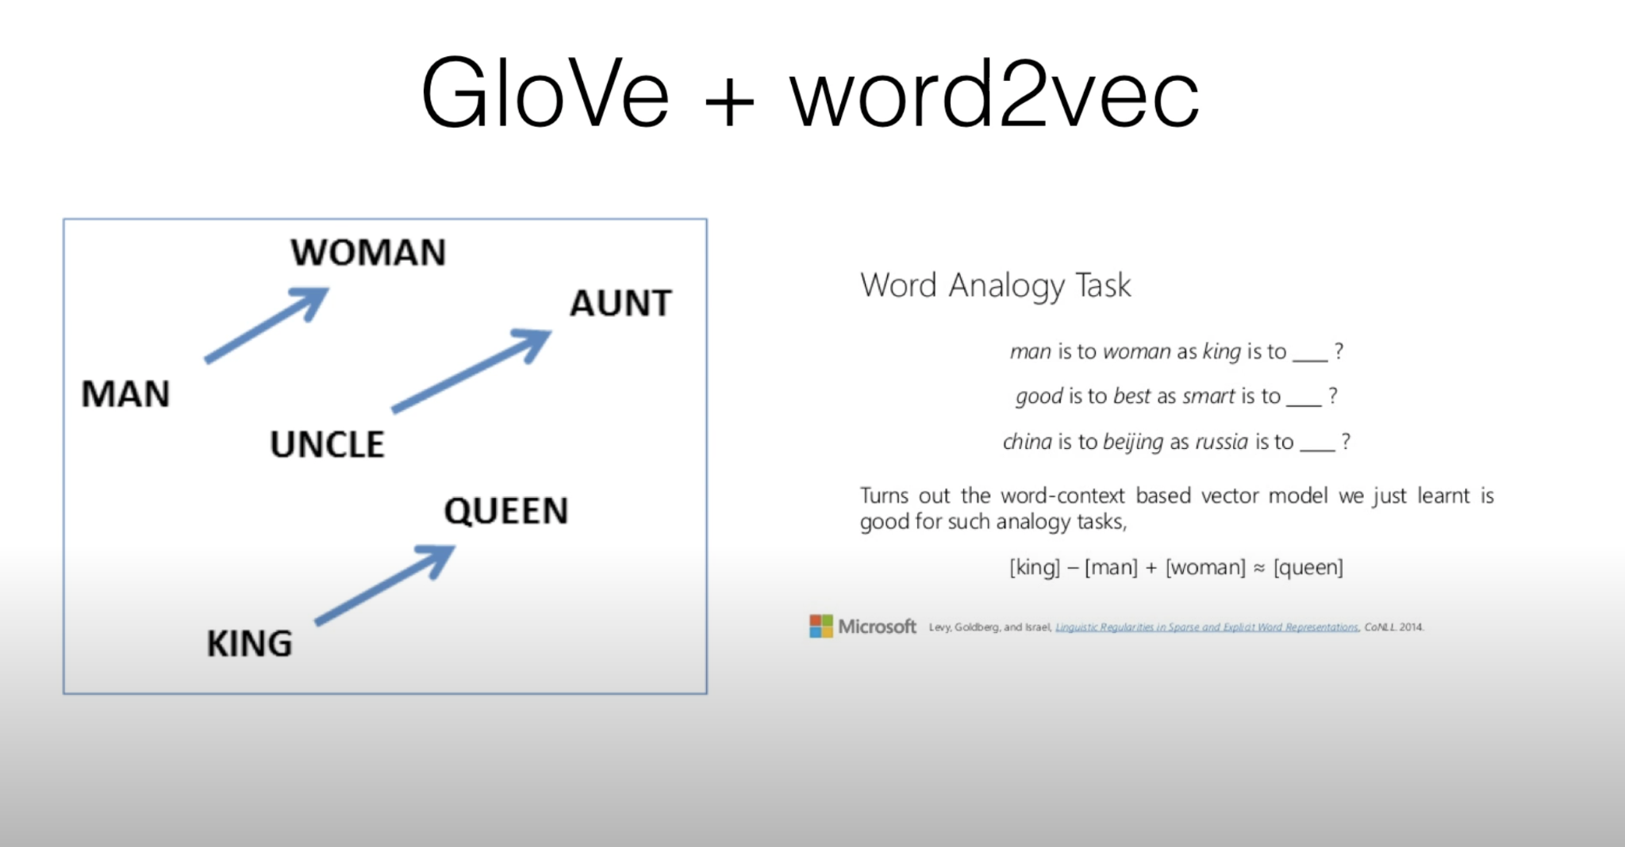
GloVe + 1D CNN - GloVe
(Stanford, 2014)

Slide 21
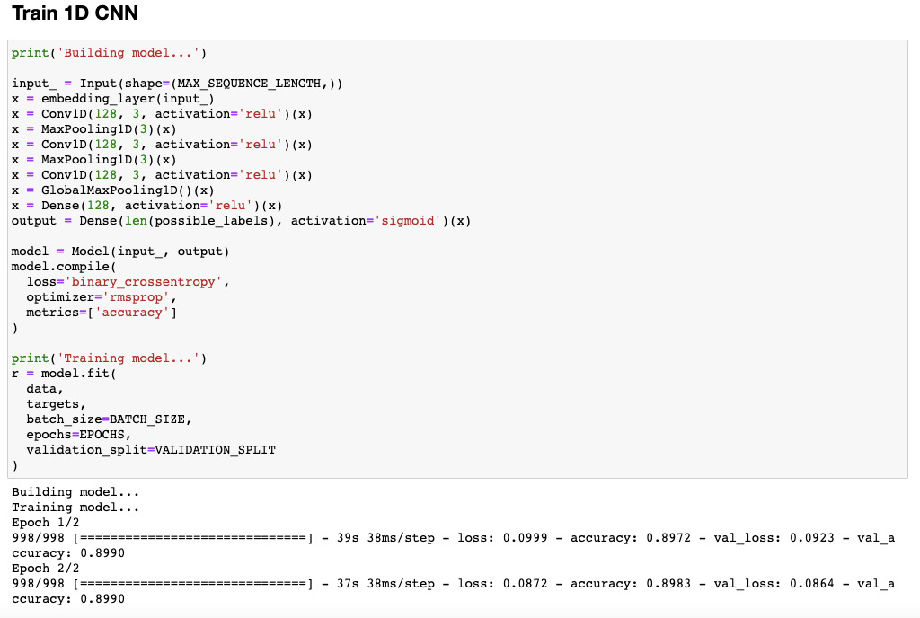
GloVe + 1D CNN - Training Code

Slide 22
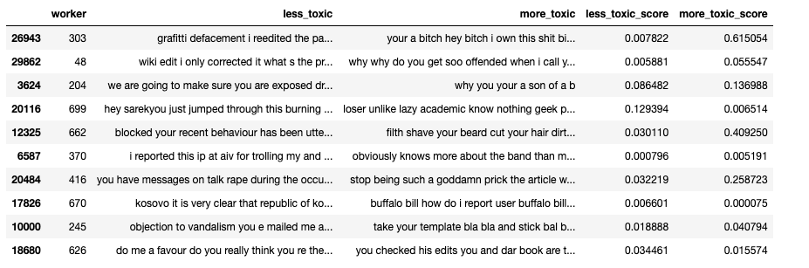
GloVe + 1D CNN - Sample Results + Accuracy
Accuracy: 66.24%

Slide 23

We have explored the following tools/models for our task:
Existing Tool:
VADER
Unsupervised Learning Model (with the 4th competition’s validation data):
Word2Vec + KMeans Clustering
Supervised Learning Model (with the 1st competition’s training data):
LSTM
Ridge Regression with TF-IDF
Transformer/BERT
GloVe + CNN
The accuracies on our validation data are within the range from 58% - 69%.

